Slide 1

Capstone Project II
FOODIE-FI
DONE by THIVYA
ON 21 JUNE 2022

Slide 2
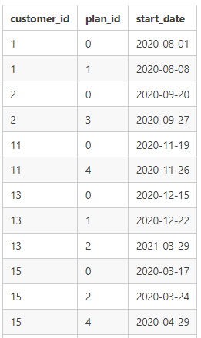
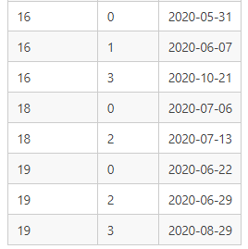
I. A brief description about each customer’s onboarding journey from a sample of 8 customers:

Slide 3
Onboarding journey…
Customer 1 has started his trail plan on 01 Aug,2020 and successfully upgraded to basic monthly plan at the end of 7 days of trail.
Customer 2 has attempted his trail plan on 20 Sep,2020 and successfully upgraded to pro annual plan at the end of 7 days of trail on 27th September.
Customer 11 has opted trail plan on 19 Nov,2020 and unfortunately cancelled his subscription and now he is running through his churn plan at a null price after his trail period.
Customer 13 has started her trail plan on 15 Dec,2020 and successfully upgraded to basic monthly plan at the end of 7 days of trail then to pro monthly plan after 3 months.
After enrolled for a trail period customer 15 has selected his pro monthly plan and then it seems that he has cancelled at the end of the next month now he has been in churn plan at null price.

Slide 4
Contn…
At the end of trail customer 16 opted for basic plan initially then pro annual plan after 4 months of usage.
Customer 18 has successfully upgraded for pro monthly plan.
Within 2 months of usage of pro monthly plan cus.19 has opted for a pro annual plan.

Slide 5
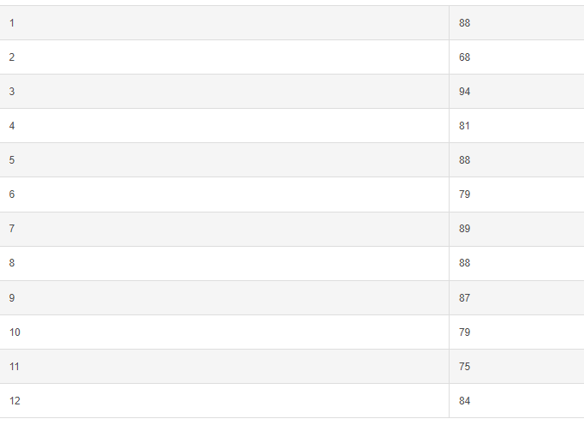
B. Data Analysis Questions
1.How many customers has Foodie-Fi ever had?
SELECT count(distinct customer_id) FROM
foodie_fi.subscriptions; 1000 customers
2. What is the monthly distribution of trial plan ?
SELECT extract(month from start_date) as month,count(plan_id) as num_of_trails
FROM foodie_fi.subscriptions
where plan_id=0
group by 1
order by 1; (or)
select monthname( start_date) as month_name,count(customer_id) as num_customers
from subscriptions
group by 1 order by start_date

Slide 6
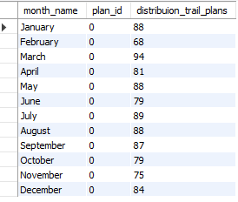
2. What is the monthly distribution of trial plan?
select monthname( start_date) as
month_name,
plan_id,
count(plan_id) as distribuion_trail_plans
from subscriptions
where plan_id=0
group by 1 order by start_date

Slide 7
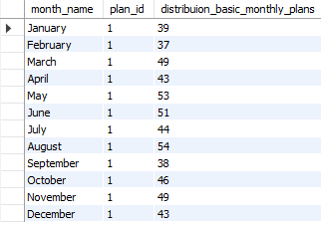
3. What is the monthly distribution of basic monthly plan?
select monthname( start_date) as month_name,
plan_id,count(plan_id) as
distribuion_basic_monthly_plans
from subscriptions
where plan_id=1
group by 1
order by start_date

Slide 8
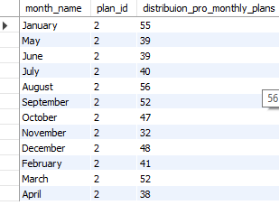
4. What is the monthly distribution of pro monthly plan?
select monthname( start_date) as month_name,
plan_id,count(plan_id) as
distribuion_pro_monthly_plans
from subscriptions
where plan_id=2
group by 1
order by start_date

Slide 9
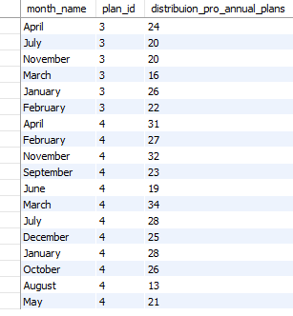
4. What is the monthly distribution of pro annual plan and churn plans?
select monthname( start_date) as month_name,
plan_id,
count(plan_id) as distribuion_pro_annual_plans
from subscriptions
where plan_id=3 group by 1
union
select monthname( start_date) as month_name,
plan_id,
count(plan_id) as distribuion_churn_plansfrom subscriptions
where plan_id=4
group by 1 ;

Slide 10
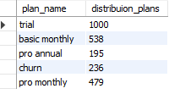
5. What plan start_date values occur in the year 2020 for our dataset? Show the breakdown by count of events for each plan_name
select plan_name,
count(s.customer_id) as distribuion_plans
from subscriptions s
join plans p
on p.plan_id=s.plan_id
where (start_date) between '2020-01-01' and '2020-12-31‘
group by 1;

Slide 11

6. What plan start_date values occur after the year 2020 for our dataset?
select S.plan_id,plan_name,
count(s.customer_id) as
distribuion_plans
from subscriptions s
join plans p
on p.plan_id=s.plan_id
where (start_date) >='2021-01-01‘
group by 1 ,2
order by 3 desc;

Slide 12

7. What is the customer count and percentage of customers out of total who have churned rounded to 2 decimal places?
select churn_indicator,
total_customers,
Round((churn_indicator/total_customers)*100 ,2)as
churn_customers_percentage
From
(select plan_id,
sum(case when plan_id=4 then 1else 0 end) as
churn_indicator,
count(distinct_customer_id) as total_customers
from subscriptions) sub

Slide 13

8.How many customers have churned straight after their initial free trial - what percentage out of total customers is this rounded to the nearest whole number?
select count(customer_id) as
churned_customers
from(
select *,lead(plan_id,1) over(partition by
customer_id order by start_date) as next_plan
from subscriptions) sub
where plan_id= '0'and next_plan=4

Slide 14

8a. What is the customer count and percentage of customers out of total who have churned rounded to 2 decimal places?
SELECT count(distinct customer_id) as customers ,
round((count(distinct customer_id)*100.0)/(SELECT count(distinct customer_id) from subscriptions ),1) as churned_customer_percent
from(select * , LEAD(plan_id,1) OVER (PARTITION BY CUSTOMER_ID order by start_date) as next_plan
from subscriptions ) as p where p.plan_id = '0' and p.next_plan = '4'

Slide 15

9. What is the number of customer plans after their initial free trial?
with next_plan_cte as
(select s.customer_id,s.plan_id,p.plan_name,
lead(s.plan_id,1) over(partition by customer_id
order by plan_id) as next_plan
from subscriptions s
join plans p
on p.plan_id=s.plan_id)
select next_plan,count(*) as
allcustomers,round((count(distinct
customer_id)*100.0)/(SELECT count(distinct
customer_id) from subscriptions ),1) as percent
FROM next_plan_cte
WHERE next_plan IS NOT NULL AND
plan_id = 0GROUP BY next_plan
ORDER BY next_plan;

Slide 16

11. How many customers have upgraded to an annual plan in 2020?
with next_plan_cte as
(select s.customer_id,
s.plan_id,
p.plan_name,
lead(s.plan_id,1) over(partition by customer_id order by plan_id) as next_plan
from subscriptions s
join plans pon p.plan_id=s.plan_id
where s.start_date>'2020-01-01' and s.start_date<'2020-12-31')
select next_plan,
count(distinct customer_id) as annnual_customers
FROM next_plan_cte
WHERE next_plan =3GROUP BY next_plan
ORDER BY next_plan;
Alternate:SELECT count(distinct customer_id) FROM subscriptions where plan_id = '3' and start_date>='2020-01-01' and start_date<='2020-12-31'

Slide 17

12. How many days on average does it take for a customer to an annual plan from the day they join Foodie-Fi?
with free_trial as (
SELECT * FROM foodie_fi.subscriptions
where plan_id = '0'
) , annual_plan as
(
SELECT * FROM foodie_fi.subscriptions
where plan_id = '3'
)SELECT round(AVG(ap.start_date - ft.start_date),0) as avg_daysforap
FROM free_trial as ft
JOIN annual_plan as ap
on ft.customer_id = ap.customer_id

Slide 18

13. How many customers downgraded from a pro monthly to a basic monthly plan in 2020?
select COUNT(*) AS downgraded
from ( SELECT *,lead(plan_id,1) over(partition by customer_id order by plan_id) as next_plan
FROM subscriptions
where plan_id=2 ) A
WHERE start_date <= '2020-12-31' AND plan_id = 2 AND next_plan = 1;

Slide 19


